Slide 1

Cache online data inside your PowerShell module – Leo Visser
Notes:
Slide 0: this slide will not automatically turned over. Show this BEFORE the acutal presentation starts.

Slide 2


Azure Network latency
West Europe
East US
1 / 20

Slide 3
Azure Network latency
West Europe
East US
6500 Km
Speed of Light in Glass: 200,000 Km/s
Time: 32.5 ms
2 / 20

Slide 4
Azure Network latency
West Europe
East US
32.5 ms * 2 due to roundtrip + extra processing
3 / 20

Slide 5
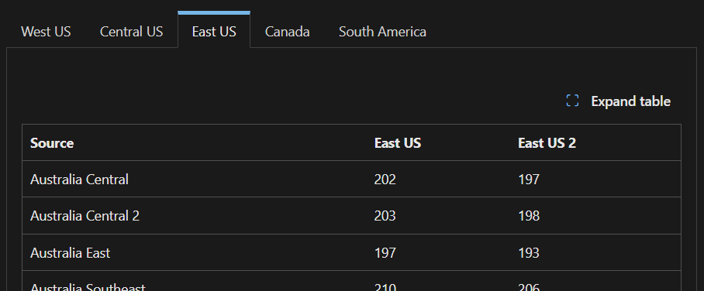
Azure Network latency
https://learn.microsoft.com/en-us/azure/networking/azure-network-latency
4 / 20

Slide 6
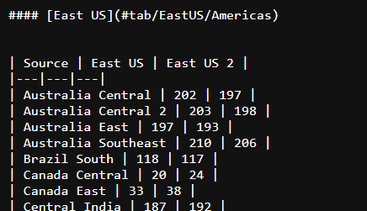
Azure Network latency
https://raw.githubusercontent.com/MicrosoftDocs/azure-docs/refs/heads/main/articles/networking/azure-network-latency.md
5 / 20

Slide 7
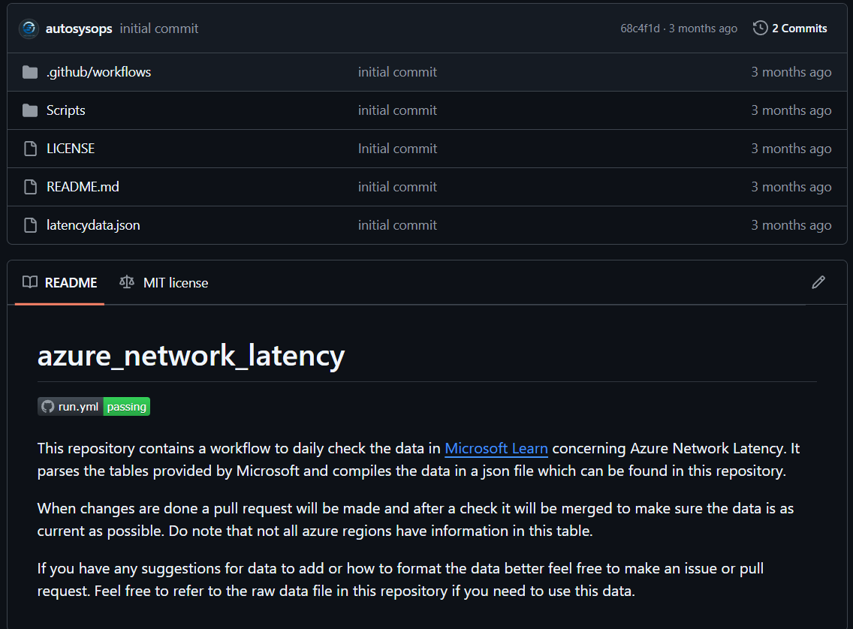
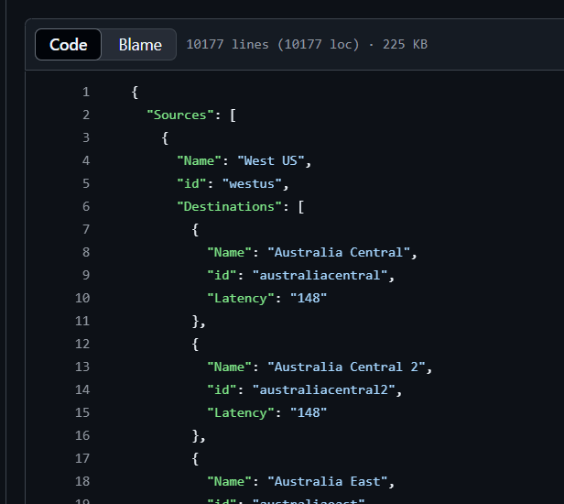
Azure Network latency
https://github.com/autosysops/azure_network_latency
6 / 20

Slide 8
Creating a module
Scaffolding (thanks Friedrich Weinmann): https://github.com/PowershellFrameworkCollective/PSModuleDevelopment Telemetry (thanks Jan-Hendrik Peters): https://github.com/nyanhp/TelemetryHelper
7 / 20

Slide 9
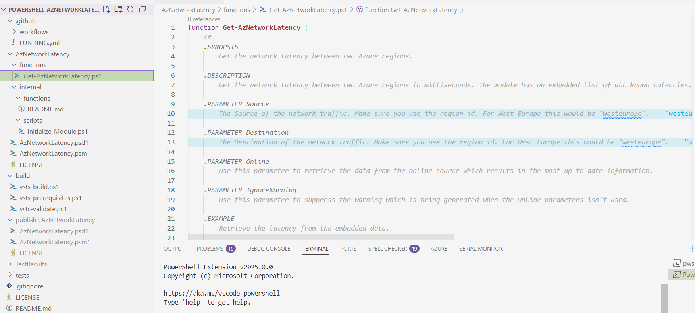
Creating a module
https://github.com/autosysops/PowerShell_AzNetworkLatency
8 / 20

Slide 10



Creating a module
Get latency
Get data
Return latency
Return data
9 / 20

Slide 11
Creating a module
No internet
Get latency
Get data
Return latency
Return data
10 / 20

Slide 12
Creating a module
CSV/JSON file in module to call
More complex module file
Embed data directly in PSM file
Need to be added to build script
11 / 20

Slide 13

Creating a module
PSModuleDevelopment
Function 1
Module.psm
Build script
Function 2
Function 3
12 / 20

Slide 14

Creating a module
PSModuleDevelopment
Function 1
Module.psm
Build script
Function 2
Data
Function 3
13 / 20

Slide 15

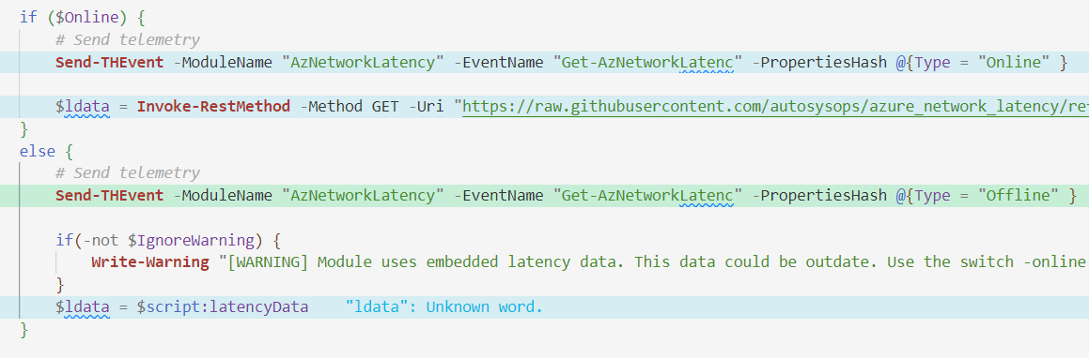
Creating a module
PSM file
14 / 20

Slide 16
Creating a module
PSM file
15 / 20

Slide 17
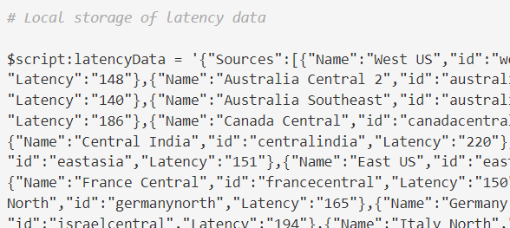
Creating a module
PSM file
16 / 20

Slide 18
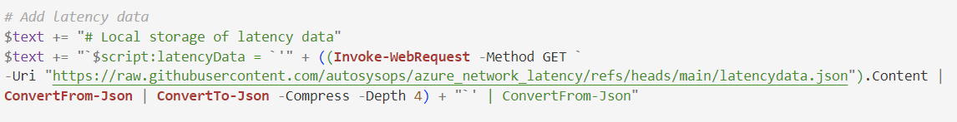
Creating a module
Build file
17 / 20

Slide 19
Recap
Don’t forget to:
Test if data is added during build
Update cached file when new version is available
Explain the –online parameter in the help
18 / 20

Slide 20
Recap
Less network calls = less energy waste
Faster execution
Allows for offline use
Allows for version pinned module with new data
19 / 20

Slide 21


Recap
Connect with me
Get Module
20 / 20

